Slide 1
Machine learning pipeline on cloud
Predictive analysis

Slide 2
Team members
Name | Roll Number | SAP ID
Aditya Kumar | 04 | 500066319
Anuj Verma | 09 | 500069910
Mayank Joshi | 25 | 500070105

Slide 3
Problem statement
Develop and Deploy a Machine Learning Pipeline on Cloud and make it accessible through browser

Slide 4
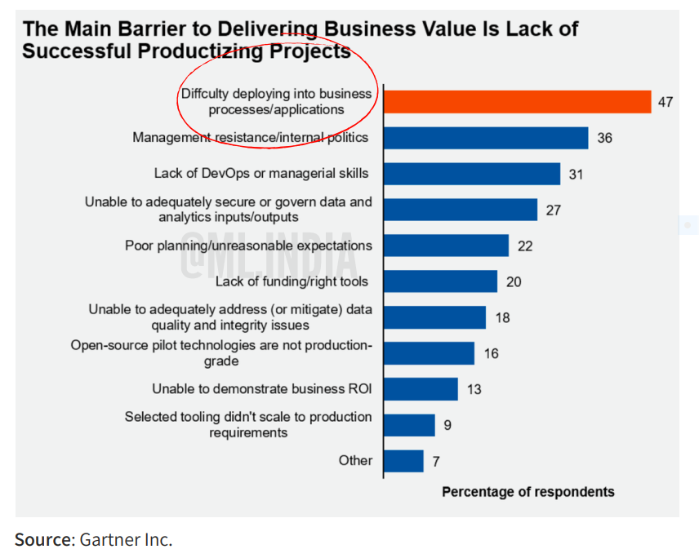
Goal
Develop a Machine Learning Pipeline
Create a Web Application and UI for the Pipeline
Manage the Pipeline through VCS
Deploy the Pipeline on Cloud Platform and make it accessible through browser

Slide 5
Workflow of the project
Acquiring the Dataset
Importing the Dataset into Jupyter Notebook and performing EDA, Cleaning and Basic Visualization to understand the data
Get insights to the data and develop a suitable Machine Learning Model
Training the ML Model and Testing for accuracy
Writing the trained ML Model to a Pickle (.pkl) file
Developing a WebApp and Single page website for the project
Committing the whole project on GitHub and integrate it with Heroku
Deploy the WebApp

Slide 6
Tools used
Python Programming Language
Machine Learning Algorithm
Flask Framework
Jupyter Notebook
Heroku Cloud
GitHub (Version Control System)
Tableau (Data Visualization)

Slide 7
The dataset
Variable | Description
Car Name | Names of the vehicles
Year | Year of purchase
Selling Price | The prices these vehicles were sold for
Present Price | The prices these vehicles were bought for
Kms Driven | Total kilometers driven by the vehicle
Fuel Type | The type of fuel a vehicle used (Petrol, Diesel or CNG)
Seller Type | Who is selling the vehicle (Dealer or Individual)
Transmission | Transmission system of the vehicle (Manual or Automatic)
Owner | Count of previous owners of a particular vehicle
The dataset we used for this project is a collection of prices of different vehicles available in Indian markets.
The dataset is made of total 302 rows and 10 columns.
The type of variables in this dataset are described in the table.

Slide 8
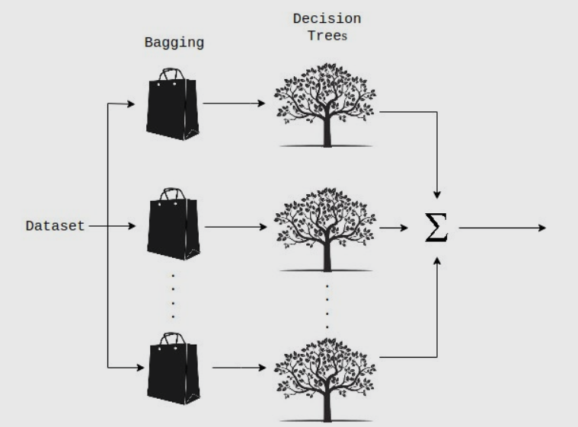
The ML Algorithm: Random forest regressor
It is an ensemble technique capable of performing both regression and classification
Random Forests build multiple decision trees and merge their predictions together to get a more accurate prediction
The technique of combining predictions of n different models is called bagging

Slide 9
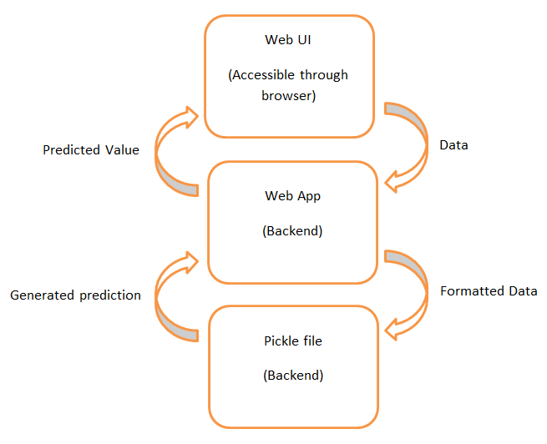
The webapp
The Web Application is developed using Python Flask Framework
The user is required to enter data through the Web UI
The raw data gets sent to the WebApp
It then is converted into required format
The WebApp then opens the Pickle file and feeds the data
The .pkl file then computes the data and generated a prediction and returns the predicted value to the WebApp
The WebApp then displays this predicted value on the UI

Slide 10
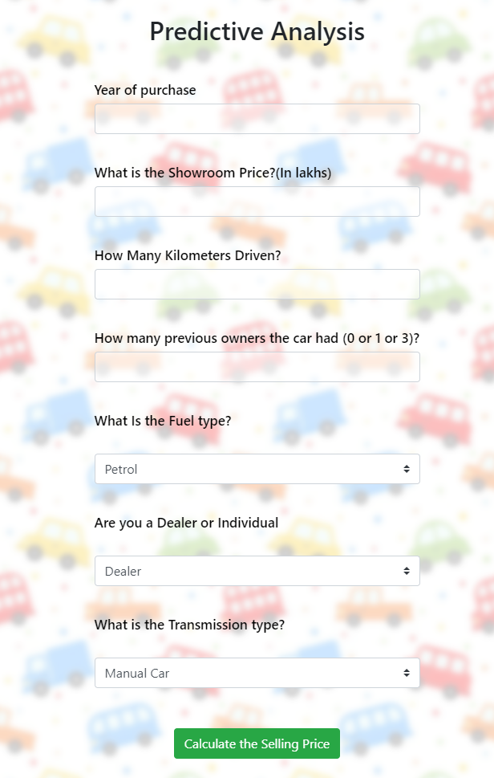
Deploying the webapp
Deploying the WebApp was the last phase of the project
The project is deployed on Heroku using GitHub repository for hosting files.
Why we used Heroku?
It is free to use
Deploying is easy on Heroku
Environments are easy to maintain
It supports Python as backend

Slide 11
References
Scikit Learn Random Forest Regressor
Seaborn Data Visualization Library
Matplotlib Data Visualization Library
Dataset used for the project
Random Forest Regressor

Slide 12
end

